Slide 1

WWW.LYTLE-ELECTRIC.COM

Slide 2


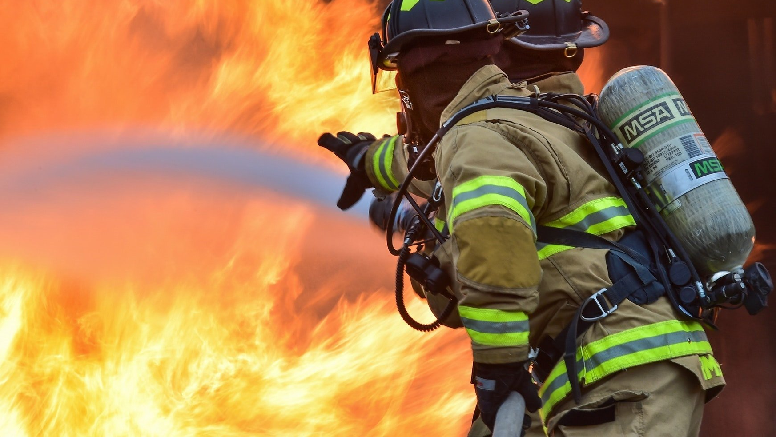
Electrical Fire Safety Awareness

Slide 3
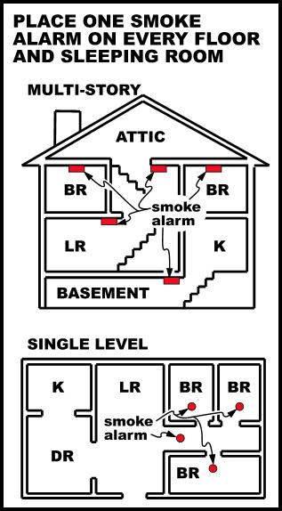
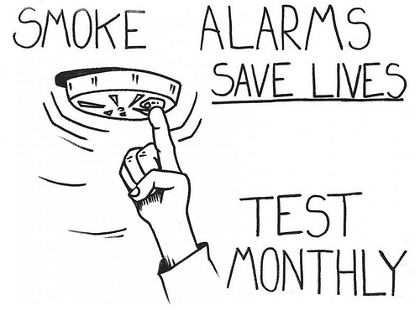
Smoke and CO2 Detectors
This Photo by Unknown Author is licensed under CC BY
This Photo by Unknown Author is licensed under CC BY-SA

Slide 4
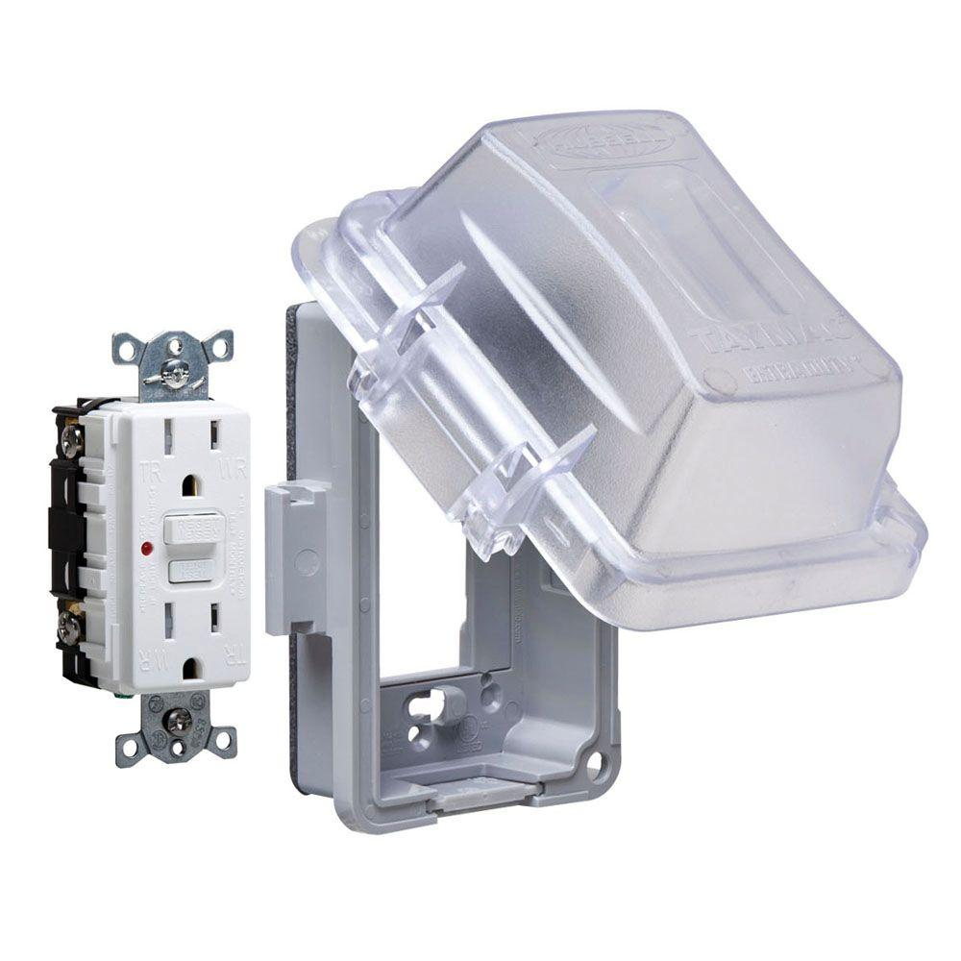
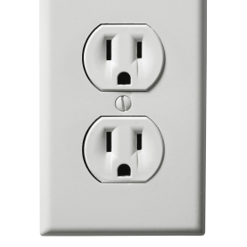
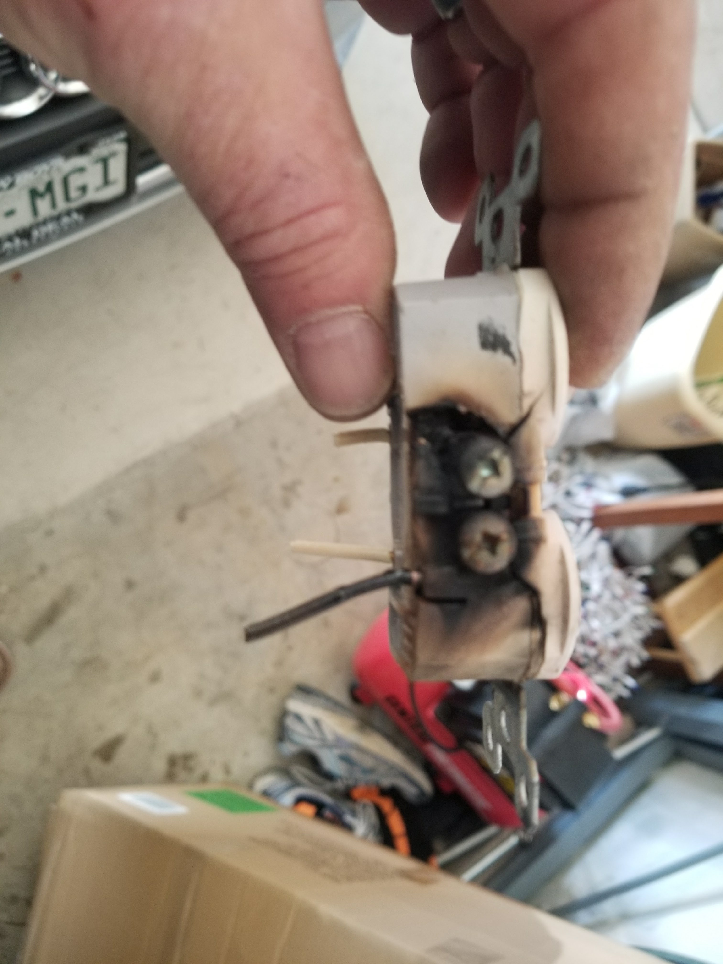
Home Inspections
Tamper Resistant Outlets
GFCI Outlets
Kitchen
Bathrooms
Garage
Outside with WR/GFCI
This Photo by Unknown Author is licensed under CC BY-SA
This Photo by Unknown Author is licensed under CC BY-SA

Slide 5
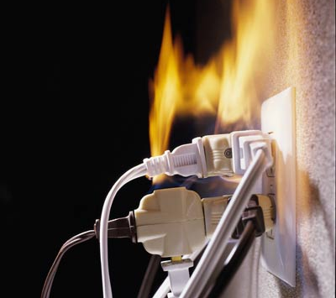
Overloaded outlets
This Photo by Unknown Author is licensed under CC BY-SA-NC

Slide 6
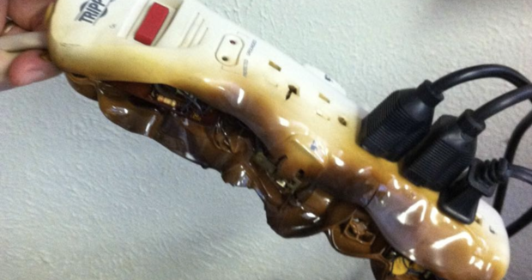
Space heaters and power strips
This Photo by Unknown Author is licensed under CC BY-NC-ND

Slide 7
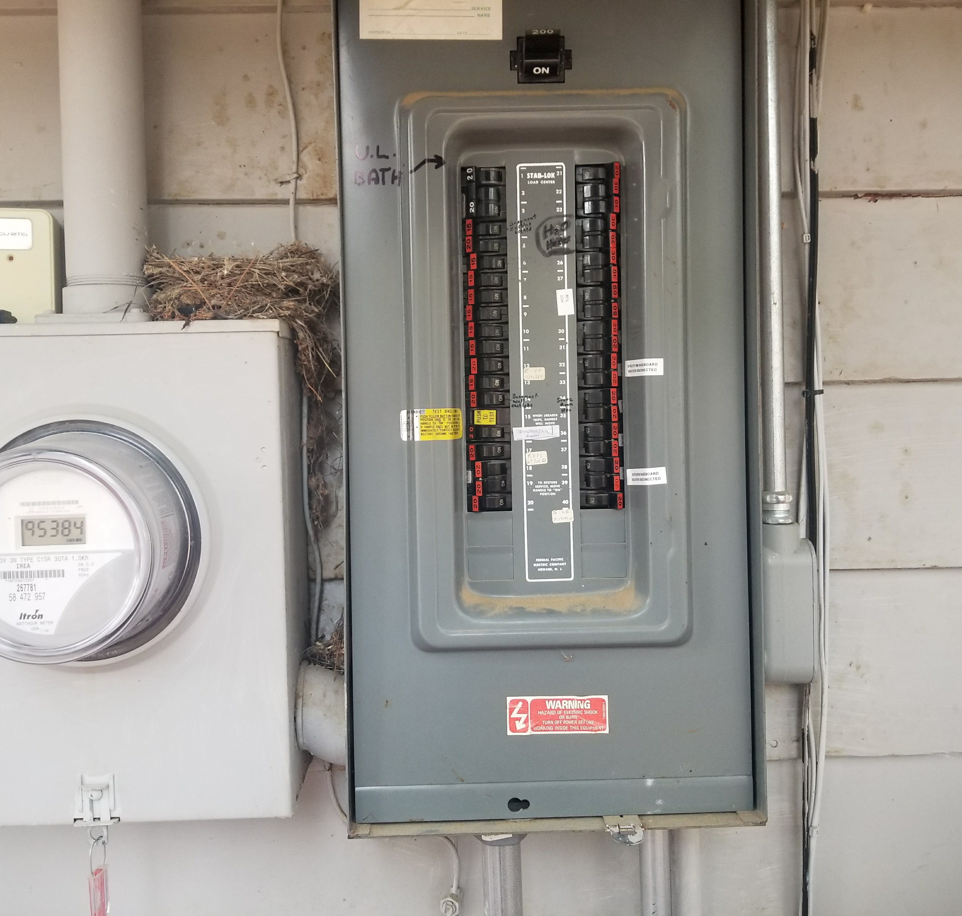
Panel Inspections

Slide 8
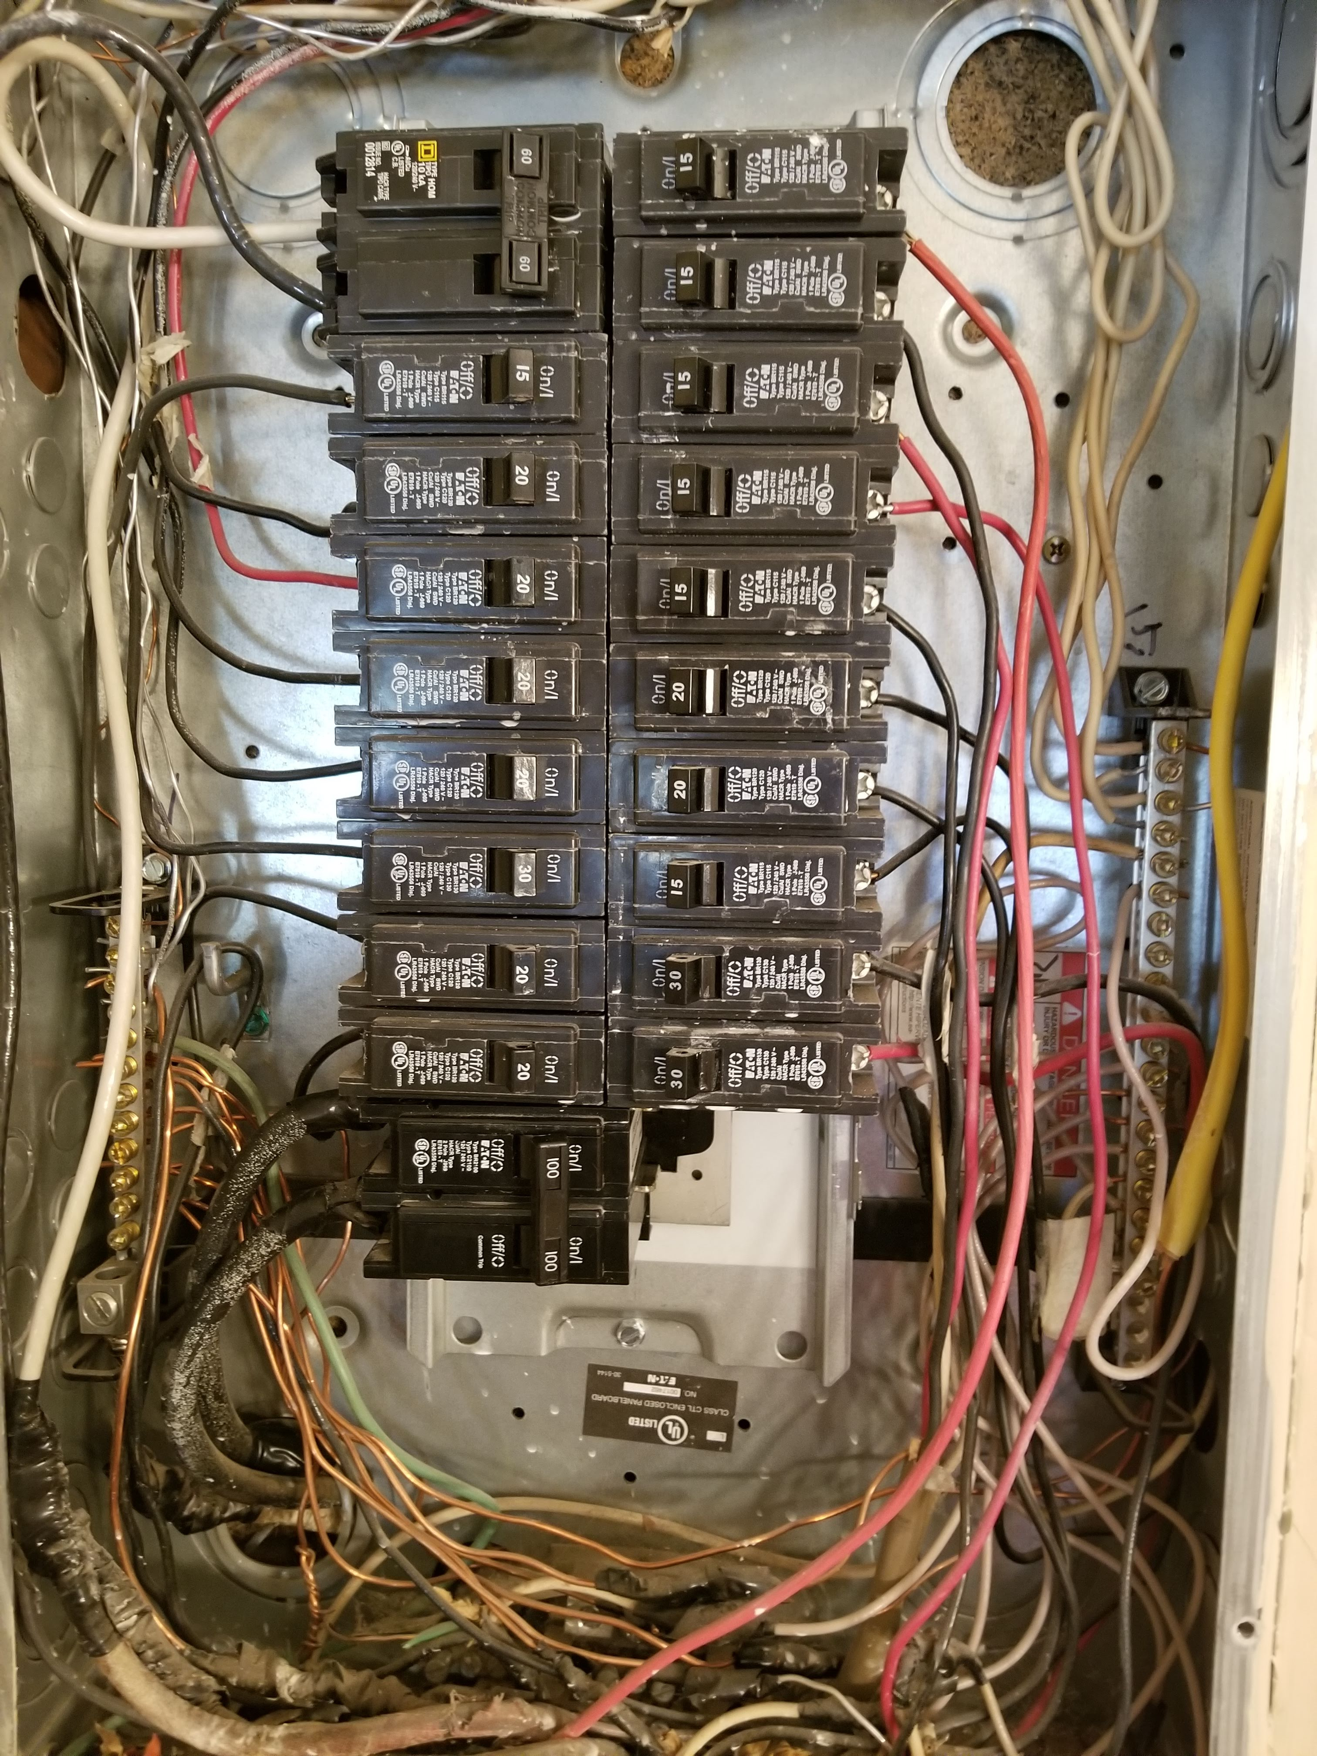
Federal Pacific Panels
https://blog.hsb.com/2016/03/17/bad-circuit-breaker/
WFHades?!!
https://www.cpsc.gov/content/commission-closes-investigation-of-fpe-circuit-breakers-and-provides-safety-information-for

Slide 9
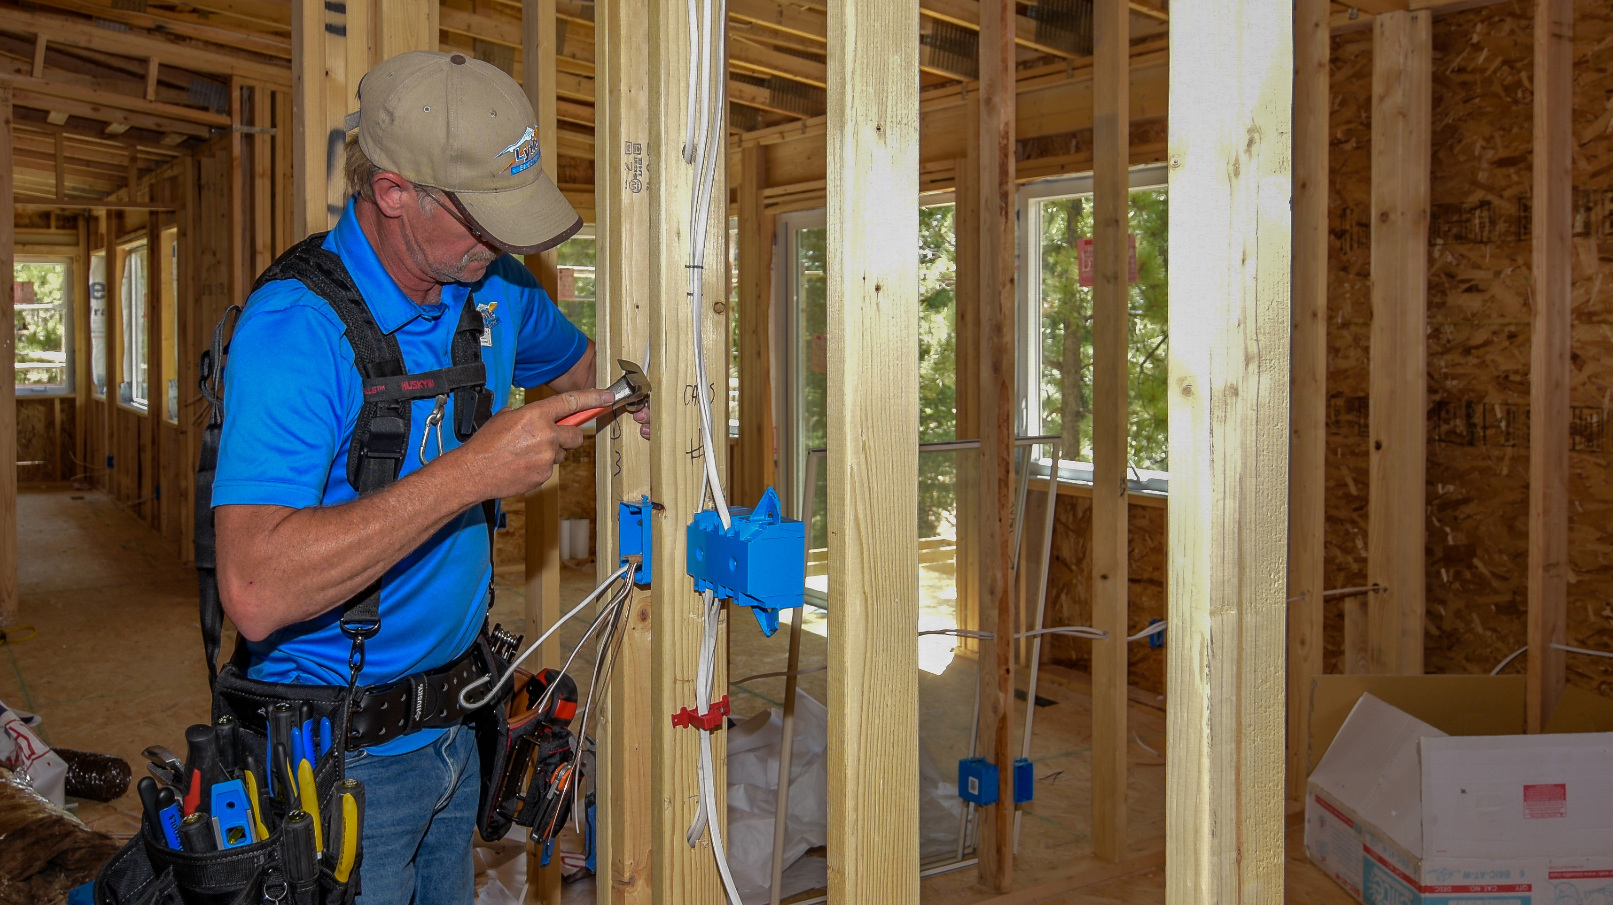

We have great news!
Coming Soon:
Check us out on Amazon
This Photo by Unknown Author is licensed under CC BY-SA-NC

Slide 10

WWW.LYTLE-ELECTRIC.COM

